Slide 1
A Whole New Mind Why Right Brainers Will Rule the Future
Daniel H. Pink

Slide 2
Overview of The Book
In this book, the author has tried to convince the readers that we are experiencing a transition to a new age, which he calls ‘The Conceptual Age’, and tries to equip us with abilities that a person needs in order to excel in this new age.

Slide 3
Contents
S. No | Topics | Slide No. | S. No. | Topics | Slide No.
1 | The Conceptual Age |  | 2 | The Six Senses
 | Right Brain Rising | 5 |  | Design | 14
 | Abundance and Asia | 6 |  | Story | 15
 | Automation | 8 |  | Symphony | 16
 | High Concept, High Touch | 9 |  | Empathy | 17
 |  |  |  | Play | 18
 |  |  |  | Meaning | 19
Summary: Slide No. 20

Slide 4
PART ONE The Conceptual Age

Slide 5
Right Brain Rising
Left vs. Right Brain – the old conception
The conflict
The Real Stuff
Contralateral Localization of Bodily Functions
Sequential versus Simultaneous
Text versus Context
Analysis versus Synthesis

Slide 6
Abundance and Asia
Distinguishing factors required amid abundance
Shopping Malls and Designer Products
Asia – Outsourcing
Forester Research Statistics: 3.3 million white collar jobs, costing $136 billion, will shift from U.S. to low cost countries by 2015

Slide 7
Salary Comparison (Dollars per Month)

Slide 8
Automation
The tale of John Henry
The Chess Master
Super Computers, Software, and Websites
Medicine
Accounting
Law
Programming

Slide 9
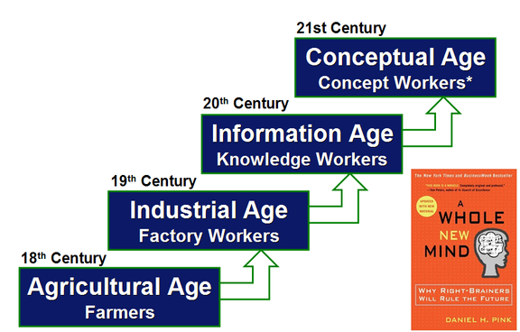
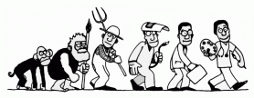
High Concept, High Touch
From the Agricultural Age to The Concept Age

Slide 10
High Concept, High Touch(continued)
High Concept is to
Create artistic and emotional beauty
Detect patterns and Opportunities
Craft a satisfying narrative
Synthesise

Slide 11
High Concept, High Touch(continued)
High Touch involves
Empathy
Human interaction
Joy
Purpose and Meaning

Slide 12
High Concept, High Touch (continued)
Yale and UCLA Medicine programmes
MBAs vs. MFAs
IQ vs. EQ
50 to 60 percent
35 to 45 percent
23 to 29 percent
15 to 20 percent
Meaning and Money

Slide 13
PART TWO The Six Senses R-Directed Aptitudes

Slide 14
Design
“I think designers are the alchemists of the future.” Richard Koshalek, President, Art Center College of Design
CHAD – solving problems, understanding others, and appreciating the world around oneself.
The Democracy of Design – fonts
Health Care research
Al Gore vs. Bush

Slide 15
Story
Fact vs. Story
The ability to place facts in context and to deliver them with emotional impact – story.
E. M. Forster
“The queen died and the king died.”
“The queen died and the king died of a broken heart.”
Robert Mckee – the screenplay teacher
Story and the organizational culture
Story of healing – the narrative medicine

Slide 16
Symphony
What is ‘Symphony’?
Seeing Relationships
Drawing
The Boundary Crosser
The Inventor
The Metaphor Maker
Seeing the big Picture
Negative Space

Slide 17
Empathy
To stand in someone else’s shoes
Facial Expressions
Ekman and Darwin
A whole new health care
Men, women and empathy
Empathize
Volunteer

Slide 18
Play
Madan Kataria vs. Ford Motor Company of 1930s
Games
America’s Army by America’s Army
Humour and the Right Brain
Joyfulness
Laughter

Slide 19
Meaning
Victor Frankl
Logos at Auschwitz
Taking Spirituality Seriously
Dalai Lama at MIT
Medicine
Taking Happiness Seriously
“You’re not going to find the meaning of life hidden under a rock written by someone else. You’ll only find it by giving meaning to life from inside yourself.” – Dr. Robert Firestone, author and psychotherapist.

Slide 20
Summary
Transition to the Conceptual Age
Reasons – Asia, Automation, Abundance
The Right Brain tools for dominance:
Design
Story
Symphony
Empathy
Play
Meaning

